Slide 1

Decoding Neural Patterns for Naturalistic Speech Perception
Guided By,
Dr. Suchithra M S
Ashutosh Rai (2020BCS0020)
Roshin Nishad (2020BCS0019)
Pratik Raj (2020BCS0112)
Sai Teja (2020BCS0145)

Slide 2
Introduction
Traditional Brain-Computer Interface (BCI) studies mainly focus on decoding neural signals during active speech or writing to produce text or speech outputs.
In these standard approaches, the individuals, actively participate by speaking or typing, and the BCI technology translates these neural signals into text or speech.
Our current research diverges from this norm by focusing on speech perception rather than production, marking a significant shift in BCI studies.
The aim is to explore neural activities associated with passive listening, offering insights into how the brain processes speech when individuals are listeners rather than active participants.
This novel approach allows for the study of complex neural patterns related to speech perception, an area less explored but notably more intricate in the context of BCIs.

Slide 3
Significance
Enhancement of Naturalistic Speech Synthesis: The project aims to improve the realism and communication aspects of speech synthesis. By decoding brain activity during passive speech perception, the project seeks to create a more lifelike method of generating speech.
Practical Implications for Speech Disabilities: The technology has the potential to significantly benefit individuals with speech-related disabilities. It can improve the quality of communication for these individuals by offering a more effective and natural way to generate speech.
Contributions to Linguistics and Cognitive Neuroscience: Beyond its practical applications, the project also contributes to academic fields. It provides valuable insights into how the human brain comprehends spoken language, thereby enriching our understanding in the fields of linguistics and cognitive neuroscience.

Slide 4
Problem Statement
The core challenge addressed by this project is the precise decoding of neural activity associated with the passive perception of speech.
Significant advancements have been made in the field of decoding neural signals related to speech production. However, there is still a considerable gap in understanding how the brain processes speech during listening, as opposed to active speaking or typing.
This project aims to address this gap by focusing on the neural patterns and representations associated with perceived speech, thereby enhancing our understanding of speech perception and potentially offering new avenues for assistive technologies.
The specific problem this project seeks to solve is the development of a robust and accurate method for converting neural signals related to passive speech perception into coherent and natural speech output.

Slide 5
Motivation
While much research has delved into the neural aspects of speech production, the passive perception of speech remains less explored. Our project seeks to understand these neural patterns, utilizing iEEG data and a FC DNN (Fully-Connected Deep Neural Network). By venturing into this understudied area of speech processing, we hope to contribute valuable insights to the scientific community.
Our broader aspiration is to enhance Brain-Computer Interfaces (BCIs) for speech synthesis. By aiming to translate neural signals from passive speech perception into clear speech output, we envision potential applications that could assist those facing communication challenges, making communication more accessible and effective.

Slide 6
Literature Review
S no. | Author(s) and Publication Year | Study Title | Key Findings | Limitations | Relevance to Project
1. | Luo, S., Rabbani, Q. & Crone (2022) | Brain-Computer Interface: Applications to Speech Decoding and Synthesis to Augment Communication | The paper explores Brain-Computer Interfaces (BCIs) as Augmentative and Alternative Communication (AAC) devices, particularly for individuals with conditions like locked-in syndrome (LIS) where traditional communication is severely limited Technology: ECoG, DNN, ML | Long-term Electrocorticography signal stability for speech decoding has not yet been fully investigated and safety of long-term ECoG implants are in question. | The paper discusses various technologies and methods, such as various machine learning algorithms, for decoding spoken phonemes and synthesizing speech.
2. | Brumberg, J. S., Kennedy, P. R. & Guenther, F. H. (2009) | Artificial speech synthesizer control by brain-computer interface | The paper uses an intracortical microelectrode device with wireless transmission to map neural firing rates in the speech motor cortex to intended speech utterances. The formant frequencies predicted by the system are synthesized in real-time, providing instantaneous auditory feedback for closed-loop BCI control. Technology: Kalman Filter Algorithm | The study is limited to a single subject, which may not provide a comprehensive understanding of the system's applicability to a broader population. | The paper provides a robust framework for decoding neural signals to facilitate artificial speech production. This methodology could serve as a foundational reference for the decoding of neural patterns associated with speech perception
3. | Herff C, Heger D, de Pesters A, Telaar D, Brunner P, Schalk G and Schultz T (2015) | Brain-to-text: decoding spoken phrases from phone representations in the brain. | Describes the design and development of a Brain-to-Text system that uses neural phone models and language information to decode spoken phrases from brain activity. Technology: ECoG, Neural Phone Models, Language Models | In this study, only one context-independent model is trained for each phone, i.e., without consideration of preceding or succeeding phones due to the limited amount of data | The approach introduced here may have important implications for the design of novel brain-computer interfaces, because it may eventually allow people to communicate solely based on brain signals associated with natural language function and with scalable vocabularies.

Slide 7
Literature Review
S no. | Author(s) and Publication Year | Study Title | Key Findings | Limitations | Relevance to Project
4. | Pei, X., Barbour, D. L., Leuthardt, E. C. & Schalk, G. (2011) | Decoding Vowels and Consonants in Spoken and Imagined Words Using Electrocorticographic Signals in Humans | The paper focuses on decoding vowels and consonants from spoken or imagined monosyllabic words using ECoG signals in humans using techniques such as cortical discriminative mapping to identify which cortical locations held the most information about the discrimination of vowels or consonants. Technology: ECoG, Cortical Discriminative Mapping, Confusion Matrices | The focus is on monosyllabic words, which may not represent the complexity of natural language and the study relies on patients with specific medical conditions (intractable epilepsy), which might not generalize to the broader population.. | The paper offers a comprehensive approach to decoding neural signals related to specific speech elements, namely vowels and consonants.
5. | Akbari, H., Khalighinejad, B., Herrero, J. L., Mehta, A. D. & Mesgarani, N. (2019) | Towards reconstructing intelligible speech from the human auditory cortex | The paper discusses the use of a deep neural network architecture that consists of two stages: feature extraction and feature summation. This framework calculates a high-dimensional representation of the input, which is then used to regress the output of the model. Technology: Deep Neural Networks, Auditory Cortex Analysis, Vocoder Representation. | The study mentions the limited diversity of the neural responses in their recording, which limits the added information that is gained from additional electrodes. | The paper presents a deep neural network architecture that consists of two stages: feature extraction and feature summation. This framework can serve as a blueprint for the fully connected deep neural network employed in our research
6. | Schirrmeister, R.T., Springenberg, J.T., Fiederer, L.D.J., Glasstetter, M., Eggensperger, K., Tangermann, M., Hutter, F., Burgard, W. and Ball, T. (2017) | Deep learning with convolutional neural networks for EEG decoding and visualization. | The paper presents results showing that their deep learning model can effectively decode and visualize EEG data. They highlight the success of their model in understanding and representing brain signals. Technology: Deep Learning (CNNs), EEG Analysis. | The paper mentions that The flexibility of ConvNets (CNNs) may be a limitation in some brain-signal decoding scenarios. | The research underscores the efficacy of deep learning methodologies, particularly CNNs, in the intricate task of EEG decoding. Such an approach holds promise for the analysis of (iEEG) data, associated with speech perception decoding.

Slide 8
Workflow
The aim of the project is to decode neural patterns associated with speech perception through intracranial electroencephalography (iEEG) data, leveraging a rich and unique dataset
The key steps of the implementation:
1. Data collection:
We make use of a dataset containing iEEG recordings from 51 participants. The dataset is originally enriched with simultaneous fMRI (functional magnetic resonance imaging) data as well, extending the analysis to a multimodal level. The data was collected during participants' engagement with a short audiovisual film, providing a diverse and naturalistic stimulus.
2. Data Preprocessing:
Intracranial EEG data is processed to remove noise and artifacts. Data is detrended, and a bandpass filter is applied to focus on frequencies between 70 Hz and 170 Hz.
3. Feature Extraction:
High gamma (HG) features are extracted from the iEEG data to capture neural patterns associated with speech perception.
The HG extraction involves breaking down the data into time windows and applying the Hilbert transform, resulting in a time series of HG features.

Slide 9
Workflow
4. Audio Data Alignment:
The project also involves preprocessing of the audio stimulus.
Audio data is time-shifted and resampled to match the iEEG sampling rate.
Mel spectrogram features are extracted from the audio, allowing for further alignment with iEEG data.
5. Model Training:
The project employs a Fully Connected Deep Neural Network (FC-DNN) architecture to establish a connection between the iEEG-derived HG features and mel spectrogram features.
The model architecture consists of an input layer, multiple hidden layers, and an output layer. The network is trained to minimize mean squared error loss, optimizing the mapping between neural responses and speech perception.
6. Model Validation and Selection:
Model performance is monitored using a validation dataset to ensure it generalizes well.
Early stopping criteria are in place to prevent overfitting.
The best-performing model is saved for further use.

Slide 10
Workflow
7. Predictions and Audio Synthesis:
The trained model is used to predict mel spectrogram features from iEEG data, providing a direct link between neural activity and speech perception.
Predicted features are then transformed into audio, offering synthesized audio representations of perceived speech.
8. Results Evaluation:
The quality and accuracy of the synthesized audio are assessed by comparing it to the original audio stimulus.

Slide 11
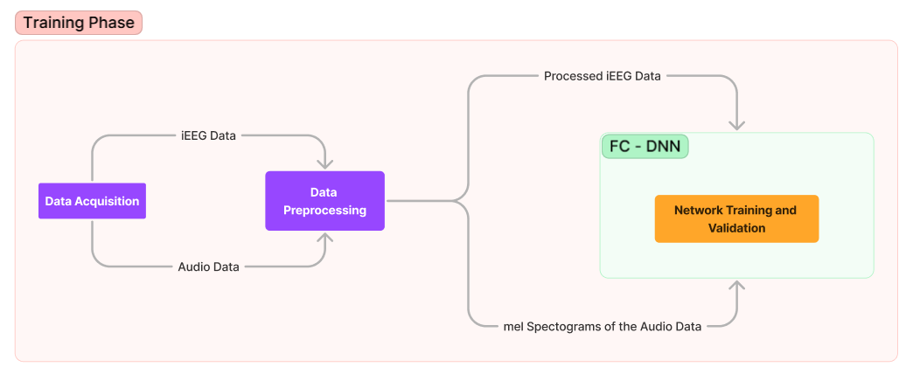
Workflow Diagram

Slide 12
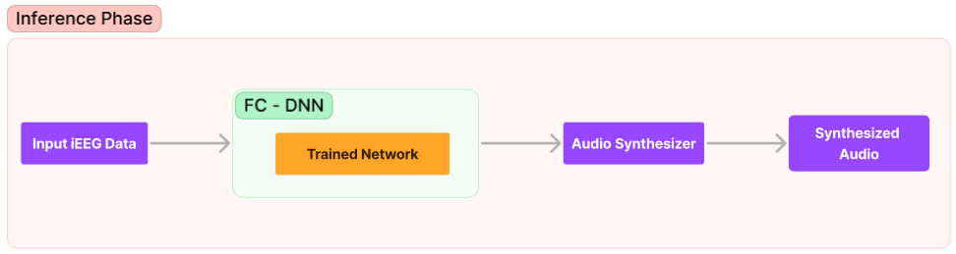
Workflow Diagram

Slide 13
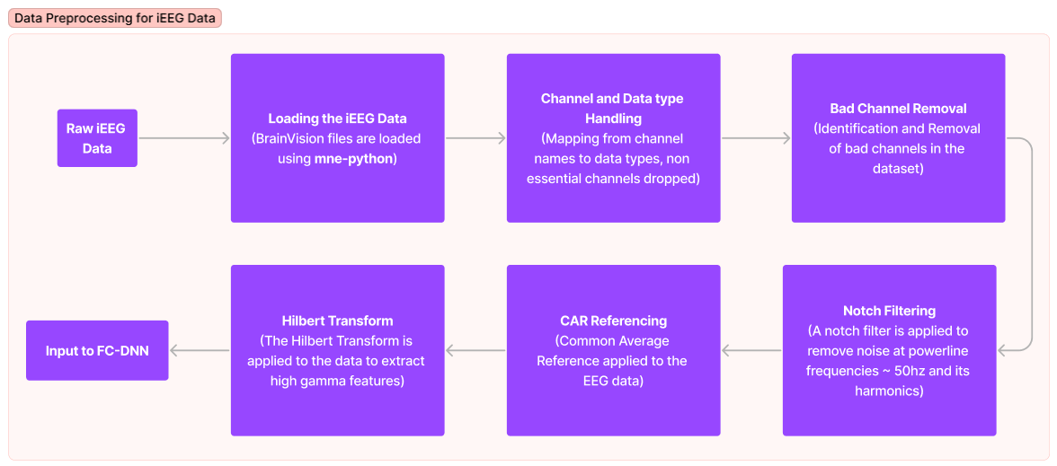
Workflow Diagram

Slide 14
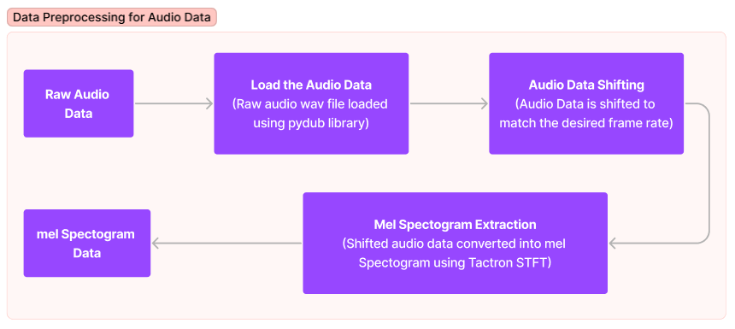
Workflow Diagram

Slide 15
Conclusion
In conclusion, our current work focuses on implementing a fully connected deep neural network (FC-DNN) for our project. However, our future work will extend beyond this as we plan to explore the application of a 2D Convolutional Neural Network (2D CNN) in the same context. This will provide us with valuable insights into the effectiveness and potential improvements of different neural network architectures for our speech perception project.

Slide 16
References
Luo, S., Rabbani, Q. & Crone, N.E. Brain-Computer Interface: Applications to Speech Decoding and Synthesis to Augment Communication. Neurotherapeutics 19, 263–273 (2022).
Brumberg, J. S., Kennedy, P. R. & Guenther, F. H. Artificial speech synthesizer control by brain–computer interface. In Tenth Annual Conference of the International Speech Communication Association (2009).
Herff C, Heger D, de Pesters A, Telaar D, Brunner P, Schalk G and Schultz T. Brain-to-text: decoding spoken phrases from phone representations in the brain. Front. Neurosci. 9, 217 (2015).

Slide 17
References
Pei, X., Barbour, D. L., Leuthardt, E. C. & Schalk, G. Decoding vowels and consonants in spoken and imagined words using electrocorticographic signals in humans. J. Neural Eng. 8, 046028 (2011).
Akbari, H., Khalighinejad, B., Herrero, J. L., Mehta, A. D. & Mesgarani, N. Towards reconstructing intelligible speech from the human auditory cortex. Sci. Rep. 9, 1–12 (2019).
Schirrmeister, R. T., Springenberg, J.T., Fiederer, L.D.J., Glasstetter, M. et al. Deep learning with convolutional neural networks for eeg decoding and visualization. Hum. Brain Mapp. 38, 5391–5420 (2017).

